Slide 1
Operating System Overview
Chapter 2
Last Updated 9/5/2017 1:02 PM
Notes:
An overview of OS features from a historic, evolutionary perspective.

Slide 2
OS Objectives and Functions
An OS is a software system that:
Loads, starts, and controls the execution of multiple programs.
Provides a standard interface between programs and hardware.
The design of an OS has (at least) these three objectives:
1. Convenience: The OS makes the computer system hardware convenient to use for both the application developer and end-user.
2. Evolution: Add new services and hardware to the computer system with minimal effort on the part of the user i.e. extensibility.
3. Efficiency: The OS utilizes the computer system’s resources in an efficient manner, increasing performance, resource utilization, etc.
Notes:
In modern OS, that “multiple concurrent programs”.
Efficient in that the processor spends as much time possible doing ‘useful work’ i.e. executing application instructions.

Slide 3
The OS as a Platform for System Evolution
Operating systems are designed for ‘extensibility’.
New devices can be added to an installed OS.
Device drivers can be installed or replaced without modifying or even restarting the running operating system.
In Linux, modules can be installed, queried, and removed.
OS services can be added or updated without requiring changes to existing programs.
Without requiring recompilation or redeployment of installed programs.
Notes:
Linux Modules are units of executable code that can be loaded / made part of the OS installation. Modules can be dynamically loaded into OS memory, unloaded from memory, queried, and other operations.

Slide 4
OS as a Software Services
An operating system’s design is typically presented as ‘Layered Services’ (an architectural design pattern).
Each layer access the services provided by the layer below it.
Bypassing layers is discouraged and often not possible.
Upper layers provides a ‘higher level of abstraction’ that simplifies manipulating the layer below it.
Stream > File > Data Blocks > Controller Interface > Drive Hardware

Slide 5
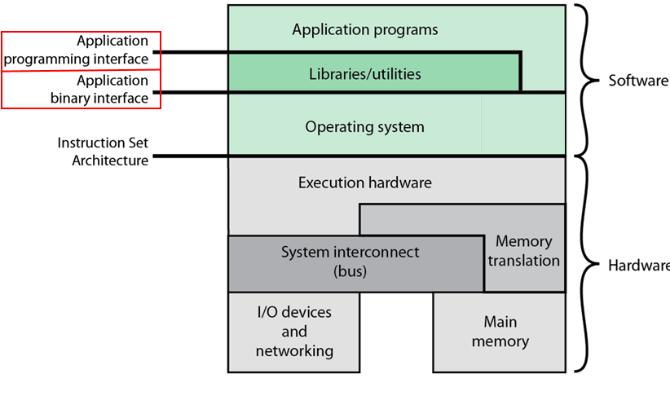
Layered Software and Hardware of an OS
Notes:
Note the boundary between Software (OS) and Hardware (Processor)

Slide 6
Operating System Software Layers
Application Binary Interface (ABI)
Services that provide access to basic Operating System services. i.e. access to the OS Kernel / privileged services.
Also known as System Calls (syscalls).
Instructions that execute in Kernel Mode.
Application Programming Interface (API)
Services provided by libraries (and utilities) that provide specific services i.e. libraries for I/O, Process Management, etc.
Programming convenience and developer’s efficiency.
Instructions that execute in User Mode.
Instruction Set Architecture
The Processor’s Instruction Set.
Notes:
API Example: printf(3): Provides a high-level service that generates a formatted stream of characters that is written to a file descriptor.
API functions do not directly manipulate the kernel but use the ABI just like the user applications.
ABI Example: write(2): Low-level service that writes a one or more bytes to a file descriptor.

Slide 7
Operating System Tools & Services
Application Development: OS provided compilers, linkers, editors, interpreters, debuggers, and other development tools.
Application Execution: OS services that load and schedule the execution of application programs (processes).
Process management, scheduling, and monitoring.
Hardware Device Interface: OS provides a common interface to families of hardware devices e.g. Disk, Network, GPU, etc.
These interfaces are called ‘drivers’.
Notes:
GPU: Graphics Processing Unit

Slide 8
Operating System Services
File Systems: Provides access to the information persistently stored on the system’s disks.
File system services are constant across different controller and drive technologies; even to files located on remote systems.
Controlled access to files based on owner and group permissions.
Controlled Access to System Resources: Provides secure access to resources managed by the OS.
Prevents programs from accessing / corrupting information that it should not have access to.
Methods of accessing resources shared between multiple programs / processes in a safe, mutually exclusive fashion.

Slide 9
Operating System Services
Error Detection: Detects and responds to errors in both the illegal access (security) and service failures.
Failures may be recoverable (e.g. file not found) or fatal (memory access violations that causes the process’s termination).
Accounting: Records information describing the performance (e.g. memory and I/O utilization), access to the system, and other events of interest.
Valid and invalid login attempts.
Messages generated by the applications (i.e. log services).
Enforcing Resource Quota (i.e. limits on the amount of disk space, processor time, memory and other system resources)

Slide 10
The OS as a Resource Manager
The operating system manages system resources that are shared among multiple programs / processes.
Memory, drive storage, network interfaces, GPU, and others.
The user program does not have direct access the system’s devices, OS Kernel (instructions and data structures), etc.
The operating system provides syscalls (ABI) that provides a program controlled access to protected resources.
The operating system ensures that programs play fair.
Processing time, memory, I/O devices, and other system resources are fairly shared between all processes.

Slide 11
The OS as a Software System
The operating system is just an executable block of processor instructions and data i.e. a special type of program.
For the system to perform any useful work, the OS must relinquish control of the processor allowing user programs to execute.
The OS loads a program into memory and starts its execution.
The OS responds to the program’s requests for services.
A goal of OS design is to minimize the amount of processor time that is spent executing the operating system.
Or.. To maximize the amount of processor time that is spent executing the user’s programs.
Notes:
OS Design Goal: Maximize Processor Efficiency i.e. maximize the number of processor cycles used to execute user processes or minimize the number of processor cycles that are used to execute OS instructions and processor idle time.

Slide 12
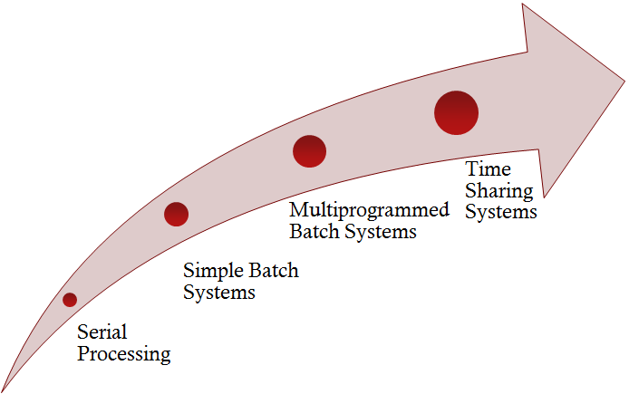
Operating System Evolution
The evolution of operating systems over the past 60 years provides insight into the reasons for, and function of, the design of modern operating systems.
The primary motivations for this evolution include:
Accommodating new OS services e.g. threads, network protocols, etc.
Providing access to multiple concurrent users.
Notes:
Describe processor utilization as 5ms to read & write data and .02ms to process the data. Utilization is .02/10.01 or .0001 or .01%

Slide 13
Serial Processing
In the beginning there was no separation between the user’s program instructions and the operating system instructions.
Original input and output methods were remarkably primitive.
Instructions were loaded into memory via control panel switches.
Lights on the control panel indicated the state of register bits.
Later, I/O devices included punch cards, paper and magnetic tape drives, and printers were introduced (see IBM 701).
Instructions and data are stored on paper “punch” cards or magnetic tape which are loaded into memory.
Human readable output was accomplished with printers.

Slide 14
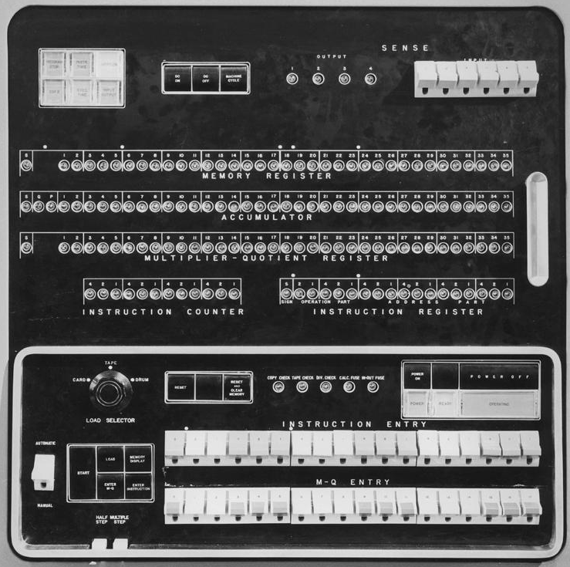
IBM 701 http://en.wikipedia.org/wiki/IBM_701
Notes:
The 701 was IBM’s first commercial mainframe system.
Instruction Counter is 12 bits wide implying that the computer had 4096 words of memory.
Op Code was 5 bits wide.
Load Selector: Card, Tape, Drum

Slide 15
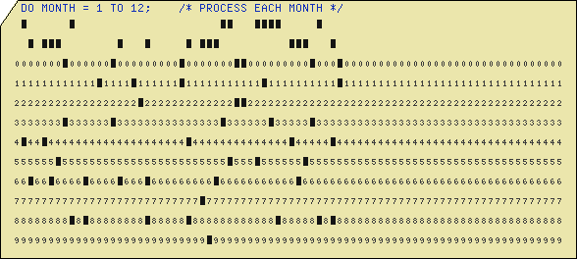
A Punch Card Containing a Single Line of Code

Slide 16
Serial Processing Shortcomings
Only a single program at a time is able to execute.
Program instructions are loaded into memory, the first instruction address loaded into the PC, and the execution cycle started.
Program setup times were largely manual and lengthy.
During which time a very expensive processor sat idle.
Common programming operations, such read / writing data to tape or later disk, were complex and error prone.
Simplified when API function libraries were invented but not necessarily part of an OS as we know it.
Notes:
Read / writing to a device required knowledge of the device (& controller) being accessed.

Slide 17
Kernel: The OS Instructions and Data
The OS Kernel is software that controls and monitors the execution of programs.
The kernel is loaded from disk and initialized when the system is started (booted).
The Kernel loads programs from disk into memory.
The Kernel manages the execution of programs.
The Kernel monitors for errors or faults signaled during the program’s execution.
If a fault is detected, the program is interrupted (terminated).

Slide 18
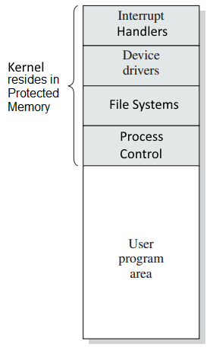
The Kernel is always resident in Memory
The Kernel is installed in a region of memory protected from access by the user’s programs.
The kernel remains loaded in memory while user programs are loaded, executed, and unloaded.
The kernel provides services needed by all user programs.
Services that provided an interface to hardware.
Services that start and control processes.
Device-controller interrupt handlers.

Slide 19
Four Innovations in Processor Design that allowed the development of Modern Operating Systems
Protected Memory
Privileged Instructions
Interrupts
Timers

Slide 20
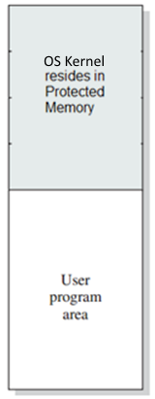
Protected Memory
System memory is divided into two regions:
Protected Memory: Contains the instructions and data structures that make up the OS Kernel.
User Memory: Contains the instructions and data structures of multiple user programs.
The user program’s execution is restricted to only its assigned user memory region.
It is unable to access the memory hosting the Kernel.
This protects the instructions and data that make up the Kernel from intentional or accidental corruption by the user’s program.
Kernel memory can only be accessed by the when the Processor is in ‘kernel-mode’.

Slide 21
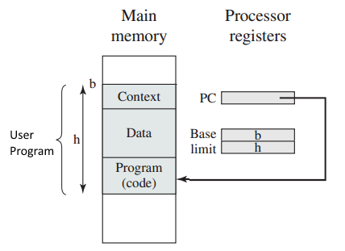
Hardware Restricted Memory Access Simple Memory Management Hardware
The Processor’s hardware restricts the program’s execution to addresses inside this region.
If the processor attempts to access an address outside of its region an ‘out of bounds’ interrupt is triggered.
Simple Memory Management Hardware Provides 2 Registers:
Base: Defines the start of the program’s memory region.
Limit: Defines the size of the program’s memory region
Notes:
Protected Memory is defined as a region of main memory that is assigned to the user’s program. If the program attempts to access a memory address that is outside of its assigned region, the processor (memory management hardware) will trigger an exception that stops the program’s execution.
The base address defines the start of the user program’s assigned memory region.
The limit address defines the size of the user program’s assigned memory region.
If the program attempts to access an address that is < the base or > base + limit, the hardware triggers an interrupt.
The base and limit register has been replaced with virtual memory and powerful (complex) memory management units.

Slide 22
Privileged Instructions
Privileged Instructions are processor instructions that perform “sensitive operations”.
Accessing devices interfaces (drivers), memory management, etc.
Privileged instructions can only be executed when the processor is in a special state called Kernel-Mode.
Privileged Instructions keep broken or malicious programs from corrupting the state of the overall system.
From reading or modifying the kernel’s internal data structures.
From directly accessing hardware devices i.e. disk drives.
Notes:
An overview of Intel’s Privileged Instructions can be found at http://support.microsoft.com/KB/114473.

Slide 23
Kernel and User Modes of Execution
The Processor runs in one of two modes (states).
In Kernel Mode, the processor has access to the entire address range and can execute privileged instructions.
Memory owned by both the OS and all other programs that are currently executing.
Also called the “Privilege Level 0” on Intel processors.
In User Mode, the processor is prevented from accessing protected memory and from executing privileged instructions.
Doing so results in a processor interrupt that stops the program’s execution.

Slide 24
Kernel and User Modes
User programs normally execute in User Mode.
Access is limited to the memory allocated to the process and the process cannot execute privileged instructions.
The processor enters Kernel Mode when interrupted. This includes:
Responding to an interrupt from hardware devices.
When processing a program’s request for services i.e. The the program makes a syscall (software interrupt).
Triggered by a processing fault (memory access violation, math error, others.).

Slide 25
Reasons for Mode Protection
Prevent a program from accidentally or maliciously damaging the instructions and data owned by the kernel and other processes.
To ensure that a process can not read from or write to the memory owned by other processors or by the kernel.
Protect and ensure the correct operation of devices and other resources managed by the OS operating system and shared between processes.
Protecting shared resources from unrestricted access by processes ensures that devices are safely and securely operated and that resources are shared fairly.

Slide 26
System Calls (SYSCALLS)
A process makes a request for operating system services though the use of the System Call (SYSCALL) mechanism.
Called the Application Binary Interface (ABI) earlier.
SYSCALLs are OS services that the program uses to access files, communicate over the network, etc.
open(), close(), read(), write(), malloc(), free(), fork(), etc.
A SYSCALL is made using the software interrupt instruction(s).
Processors provide instructions that invoke the processor’s interrupt mechanism.
Intel provides the INT(0x80) instruction (Software Interrupt).

Slide 27
The 4 Steps in Making A Linux System Call:
1. The program places the syscall number that identifies the OS request and its arguments into specific processor registers.
See slide notes for description of Linux / Intel registers.
2. The program executes an INT (software interrupt) instruction.
INT causes the processor to switch to Kernel Mode and saves the processor’s state on the control stack.
3. The interrupt handler uses the syscall number to determine the OS service being requested and executes the request in kernel mode.
4. When syscall handler finishes, it executes the IRET instruction which restores the processor state from stack and returns the processor to User Mode.
Notes:
The syscall number is placed in the EAX register.
Registers EBX, ECX, EDX, ESX, and EDI are used to pass syscall arguments.
Table 2.6 in text (pg 98) provides a list of Linux system calls by service category.
http://docs.cs.up.ac.za/programming/asm/derick_tut/syscalls.html
http://www.cs.virginia.edu/~evans/cs216/guides/x86.html

Slide 28
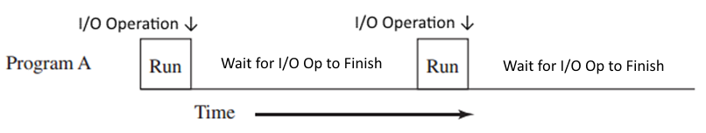
Blocking System Calls Typically I/O Operations
I/O operations are very slow compared to instruction processing
If a process makes many I/O requests, it will spend much of its runtime waiting for I/O operations to complete.
A process’s execution is blocked while waiting for its I/O operation to finish.
For example, a process can not continue execution until a read() operation has returned the requested data from disk.

Slide 29

Multiprocessing Operating Systems Also called Multitasking Systems
Multiprocessing allows multiple processes to be execute on the system ‘concurrently’ on a single processor.
The processor executes non-blocked (ready) processes.
The single processor interleaves its execution between multiple processes.
At any single point in time, only a single process is executing.

Slide 30
Preemptive Multiprocessing
Preemption is a technique that allowed multiple processes to fairly share a single processor.
A process is allowed to execute for some amount of time, and preempted (suspended) to allow another process to execute.
Process preemption occurs when a process is interrupted because of a blocking syscall or because of a ‘timer interrupt’.
Notes:
Cover timer interrupt in this slide

Slide 31
Multiprocessing is a Method of Sharing the Processor between Multiple Processes
A process executes (runs) for a specific period of time.
After its time has expired, the running process is suspended and the next process is executed.
When a process switches from running to non-running (ready) its state must be saved.
The OS provides a method of saving the state of the non-running programs called a context switch.
Information describing the state of the suspended process is maintained in the OS Kernel.

Slide 32
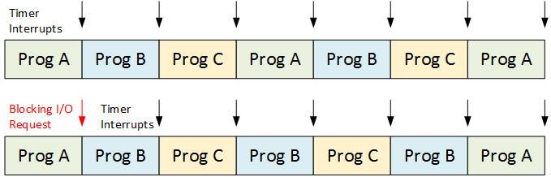
The OS uses a Timer Interrupt to preempt the execution of the currently running program
A Timer is a HW device that delivers a regular interrupt to the processor that signals the OS to perform a context switch.
The timer may signal / interrupt the processor every 10ms.
Context switch from the execution of Program A to Program B.
Notes:
In the second example, Program A is blocked while it waits for its blocking I/O request to complete.

Slide 33
Context Switching occurs when the currently executing process is replaced by another
For example, the Context Switch from Process A to B.
Process A is currently executing. i.e. the processor is executing instructions and acting on data owned by Process A.
The timer interrupt occurs ‘interrupting’ the execution of A.
The Timer Interrupt Handler, causes the processor to save the context (state) of Process A in a data structure maintained by the kernel.
The interrupt hander selects another process that is currently eligible for execution (Process B) and restores its context in the processor.
The processor returns from the timer interrupt resuming the execution of Process B where it was last interrupted.

Slide 34
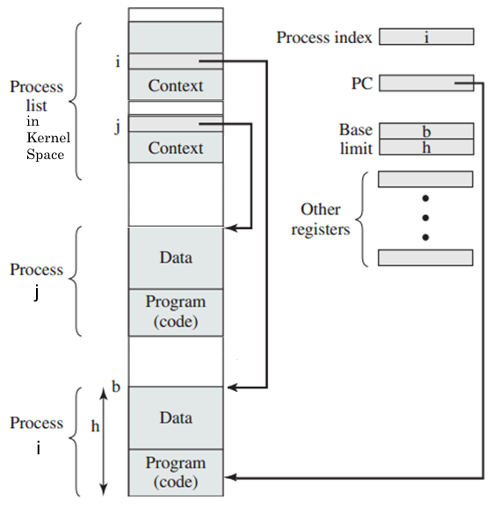
Multiple Processes Maintained in Memory
Notes:
This figure is different from what is presented in the text.
Each process’s context is maintained in a region of kernel memory.
Note that Process B is currently executing and its region is being held in the base & limit registers.

Slide 35
The Process
A unit of activity characterized by a thread of execution, the processor’s state, and an allocated set of resources.
A program executes within the context of a process.
Interrupt-driven I/O and multiprocessing allows multiple processes be co-resident in the system which raises these issues…
The Processor must switch between the execution of multiple processes.
Shard system resources (memory, I/O devices, etc.) must be fairly shared / allocated between multiple processes.
Some resources are owned by a process and must be protected from being accessed by other executing processes.
Some resources are shared between multiple processes must be protected from corruption by overlapping accesses.
Notes:
Multiple users == Time Sharing Systems.
Resources include devices, files, ‘shared’ memory segments, semaphores, queues, and other OS-managed resources.

Slide 36
The Process State
A process includes information that the operating system uses to describe and manage the process’s execution.
A process is described by …
Process ID: A unique identifier assigned by the system when the process is created..
Process State including the execution priority, Owner ID, Parent Process ID, and other OS house-keeping information.
Memory and other OS resources (buffers, files, sockets, windows, etc.) that have been allocated to the process.
Processor State describing register contents and other information that allows the process to be suspended and restored to execution.
This information is organized into a OS-managed Data Structure called the Process Context (Process Control Block).

Slide 37
Memory Management
Memory Isolation: Preventing a process from accessing the memory allocated to the OS and other processes.
Ensuring that a process can access only the memory and other resources that have been allocated to it.
Memory Allocation and Management: Allocating the limited amount of memory installed on the system to be fairly shared between multiple processes.
Allowing a process to request and return memory from / to a shared memory pool.

Slide 38
Disk and File Management
Managing Disk Storage: Allowing processes to request and return space from the shared disk drive storage.
The OS provides “File Systems” which allow the users to organize a disk’s storage capacity as File and Directories.
Operations on files include: create, open, write , read, close, and delete.
The underlying physical implementation of the storage device is hidden from the users.
Protection and Access Control: Providing authenticated and authorized access to files and other system resources.

Slide 39
Process Scheduling
The operating system is responsible for allocating computer system resources to executing processes.
Making processor resources available to multiple processes.
Scheduling “ready” processes for execution.
A “blocked” process” is not scheduled for execution until the conditions that have it blocked are resolved / completed.
E.G. A process is blocked for the duration of a read() syscall.
Ensuring that a processes is not “starved”.
Ensuring that every process is provided fair access to processor, I/O, and memory, other limited system resources.

